Slide 1
INTRODUCTION TO PSYCHOLOGY (WEEK 1)
BY: AQSA FAYYAZ
Lecturer
(Science and Humanities)
FAST - National University of Computer & Emerging Sciences

Slide 2
LEARNING OUTCOMES
Understanding the meaning of Psychology
Psychology as a science
Scope of psychology in everyday life
Goals of Psychology
Key debates in Psychology
Branches of Psychology

Slide 3

WHAT IS PSYCHOLOGY?

Slide 4
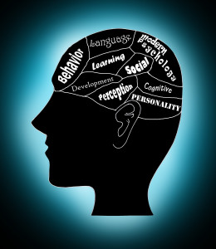

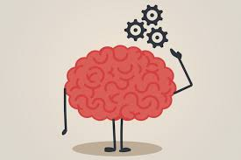

Psychology is the scientific study of behavior and mental processes.
Behavior: Outward or overt actions and reactions (observable)
Example: running, smiling, dancing, talking
Mental Processes: all internal, covert activity of mind (hidden)
Example: thoughts, dreaming, sensations, feelings

Slide 5
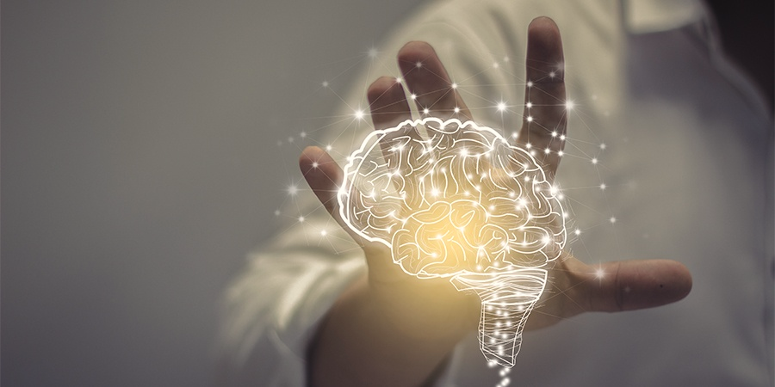
CONT.…
The word "psychology" comes from the Greek word psyche meaning "breath, spirit, soul", and the Greek word logos meaning the study of something.
Thus we can conclude that psychology is the study of soul.
Psychology is an offspring of subject philosophy.

Slide 6
PSYCHOLOGY AS A SCIENCE
Based on scientific principles that emphasizes empiricism, or knowledge based on observation
Systematic collection and examination of data (empirical evidence) to support or disprove hypotheses (predictions) rather than depending on common sense.
“Psychology is the scientific study of behavior and mental processes.”
Notes:
Empiricism: by John Locke
Based on the claim that experience is the source of knowledge. (observation through senses i.e.: sight, hearing, taste, touch and smell)

Slide 7
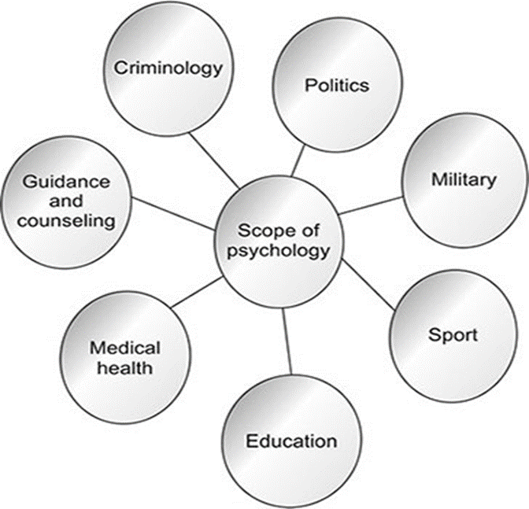
SCOPE OF PSYCHOLOGY
Psychology today covers enormous range of scope or fields.
Basic Research: Purely theoretical, with the intent of increasing our understanding of certain phenomena.
Theoretical and exploratory; seeks to answer "why" or "how" something works.
Applied Research: methods and findings of scientific psychology to solve practical problems of human and animal behavior and experience.
Solution-oriented; seeks to answer "how to" solve real-world issues.
Notes:
Basic psychology: purely theoretical, with the intent of increasing our understanding of certain phenomena or behavior but without seeking to solve or treat these problems.
Eg: A study looking at how caffeine consumption impacts the brain
A study assessing whether men or women are more likely to be diagnosed with depression
A study looking at how attachment styles among children of divorced parents compare to those raised by married parents
Applied psychology: Involves taking known psychological theories and principles to solve problems being experienced within other areas or fields
Many psychological studies on addiction reveal that the main cause of addiction is the stress factor.

Slide 8
Basic Research:
1. Examining the cognitive processes involved in decision-making to develop theories about human thought and behavior.
2. Analyzing the formation and evolution of galaxies to understand the universe's structure and history.
Applied research:
1. Implementing new teaching methods derived from cognitive psychology research to improve student learning outcomes.
2. Many psychological studies on addiction reveal that the main cause of addiction is the stress factor.

Slide 9

THINK????
How is psychology important in your field?
OR
What makes psychology important in your field?

Slide 10

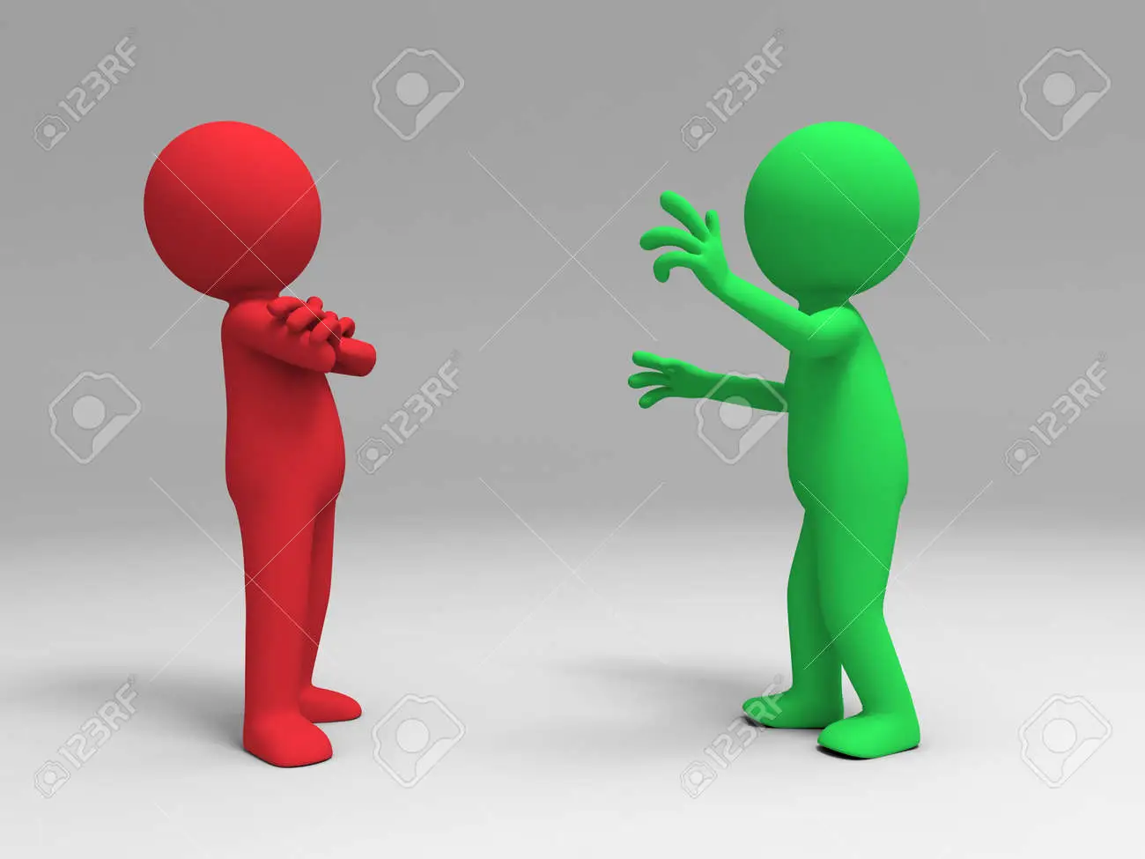
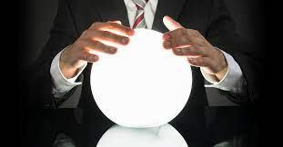

GOALS OF PSYCHOLOGY
TO DESCRIBE
(What is Happening?)
- Observing a behavior and taking note of everything that is happening.
TO EXPLAIN (Why is it happening?)
-Behavior is being understood by explaining it.
TO PREDICT (Will it happen again?)
-Determining what will happen in the future
TO CONTROL (How can it be changed?)
-To change a behavior from an undesirable one to a desirable one.
Notes:
Example: Child showing tantrums

Slide 11
CONT.…
To describe what is an organism doing?
Documenting the symptoms and behaviors associated with anxiety disorders.
To explain and understand why organism behave in certain ways?
Investigating how genetic, environmental, and cognitive factors contribute to the development of depression.
To predict how organism will behave in the future?
Predicting how a person with high stress levels might react to future stressors based on past behaviors and coping mechanisms.
To control behavior or to modify the particular behavior?
Designing and applying therapeutic techniques to help individuals manage anxiety or developing educational programs to enhance learning and memory.

Slide 12
KEY DEBATES IN PSYCHOLOGY
Nature vs. Nurture
Conscious vs. Unconscious Mind
Observable behavior vs. internal mental Processes
Free will vs. determinism
Individual Differences vs. universal Principles
These key debates are used to understand how culture, ethnicity, and race influence behavior.

Slide 13
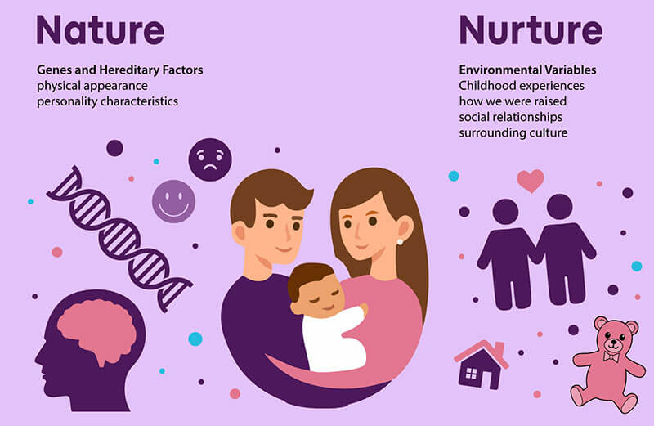
1. NATURE VS NURTURE
Heredity vs environment
How much people's behavior is due to their genetically determined nature
VS
How much is due to the influences of the physical and social environment in which a child is raised
E.g.: Intelligence, Personality Traits, Mental Health Disorders, Language Acquisition, Aggression

Slide 14
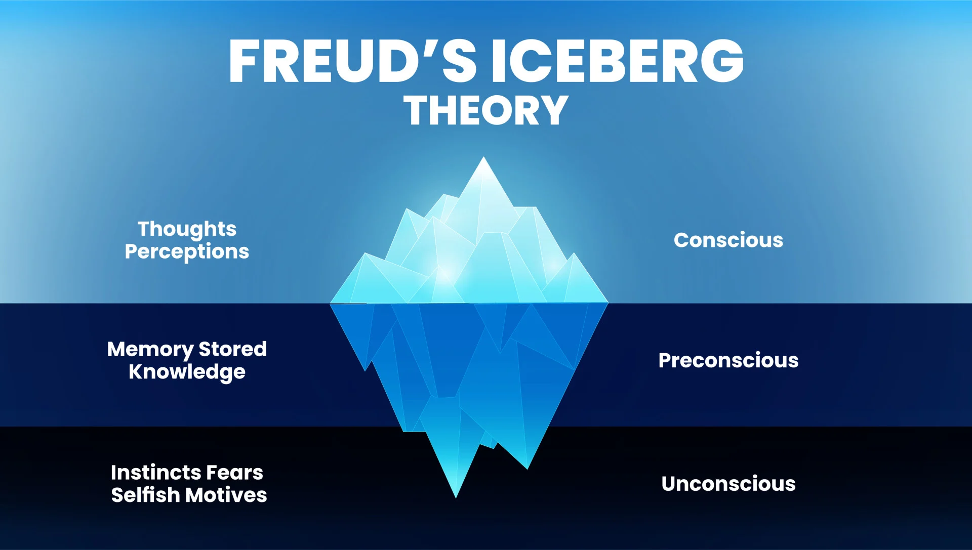
2. CONSCIOUS VS. UNCONSCIOUS MIND
How much of our behavior is produced by forces of which we are fully aware
and
How much is due to unconscious activity
– mental processes that are not accessible to the conscious mind
E.g.: Choosing what to eat for lunch Deciding which university course to study Paying attention during a lecture
Automatically reacting emotionally to certain situations
Having a fear without knowing its original cause
Dreaming

Slide 15
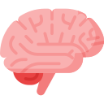
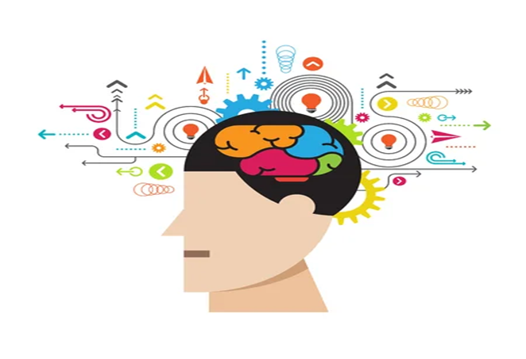

3. OBSERVABLE BEHAVIOR 👀 VS. INTERNAL MENTAL PROCESSES
Psychology should solely be concentrating on behavior that can be seen by outside observers
Behavioral psychologists think that the only source of information is behavior that can be observed directly
Psychology should focus on unseen thinking processes because according to cognitive psychologist what goes on inside a person’s mind is critical to understanding behavior.
OR
Student is motivated and thinking about getting a good grade
Student feels anxious and worries about making a mistake
Student is concentrating and processing the information
1. Student studies for 3 hours
2. Student avoids eye contact and speaks quietly
3. Student takes notes

Slide 16

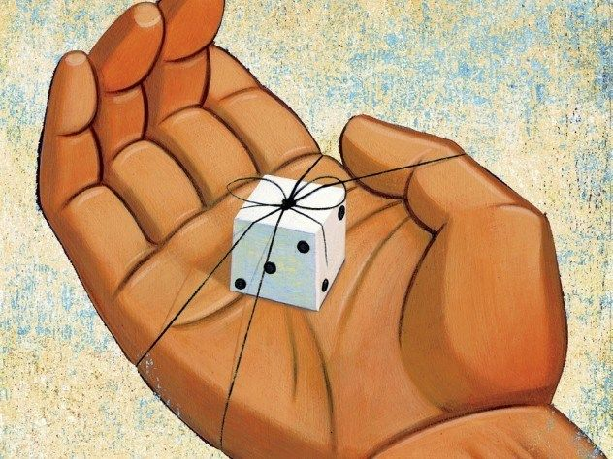
4. FREE WILL (CHOICES) VS. DETERMINISM
How much of our behavior is due to choices made freely by an individual?
We are free to choose our actions
Choosing which university course to study
Deciding to attend a lecture
Choosing to apologise after an argument
It suggests that behavior is influenced or caused by factors outside our conscious control.
The assumption that everything that happens has a cause or determinant in the observable world.
Example: child born in a poor family, will live a poor life.
GENETIC AND ENVIRONMENT
OR
E.g.: Criminal Behavior, Academic Achievement, Addiction, Personal Relationships, Career Choices

Slide 17
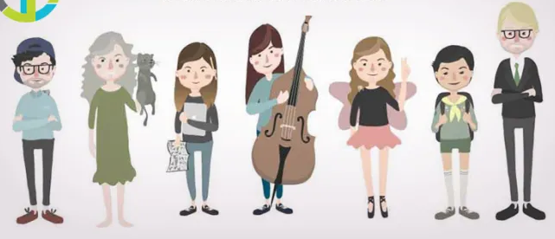
5. INDIVIDUAL DIFFERENCES VS. UNIVERSAL PRINCIPLES
Based on cultural and societal norms and values.
Memory and learning follow certain general psychological principles.
People can experience basic emotions such as happiness, fear, anger, and sadness.
Focus on the uniqueness of every individual.
Every person’s behavior is a reflection of their distinct and special individual qualities.
Some people enjoy socializing, while others prefer being alone.
Some students perform well under pressure, while others become anxious.
OR
E.g.: Personality Traits, Cognitive Development, Emotional Expression, Learning Styles, Social Norms and Behavior

Slide 18
Flash Cards — Identify the Psychological Debate
Card1 Two university students have similar academic abilities, but one performs much better because they grew up with highly supportive parents, private tutoring, and better educational opportunities.
Which psychological debate is this?
Card2 A student never answers questions in class. One psychologist focuses on what the student does, while another wants to understand the student's thoughts, feelings, and motivation.
Which psychological debate is this?

Slide 19
Card3 A student becomes extremely nervous before presentations. They don't understand why they feel this way, but later remember having a very embarrassing experience during a presentation as a child.
Which psychological debate is this?
Card4 Five students receive the same low grade. One studies harder, one becomes anxious, one asks for help, one gives up, and another doesn't seem bothered.
Which psychological debate is this?

Slide 20
Card5 A student cheats on an exam. They say they made the decision themselves, but their classmates argue that intense academic pressure and fear of failure influenced their behavior.
Which psychological debate is this?

Slide 21
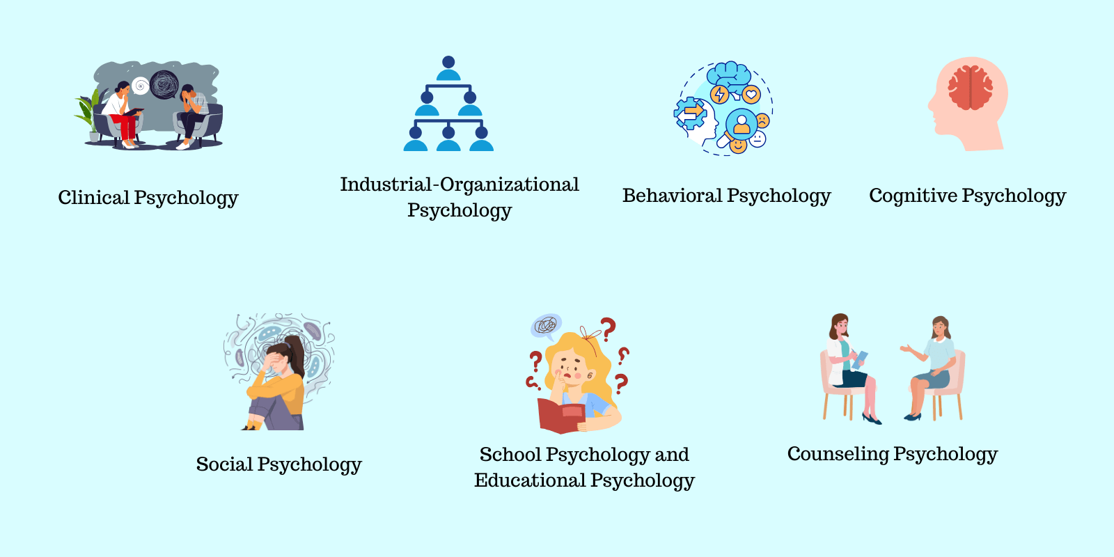
BRANCHES OF PSYCHOLOGY

Slide 22
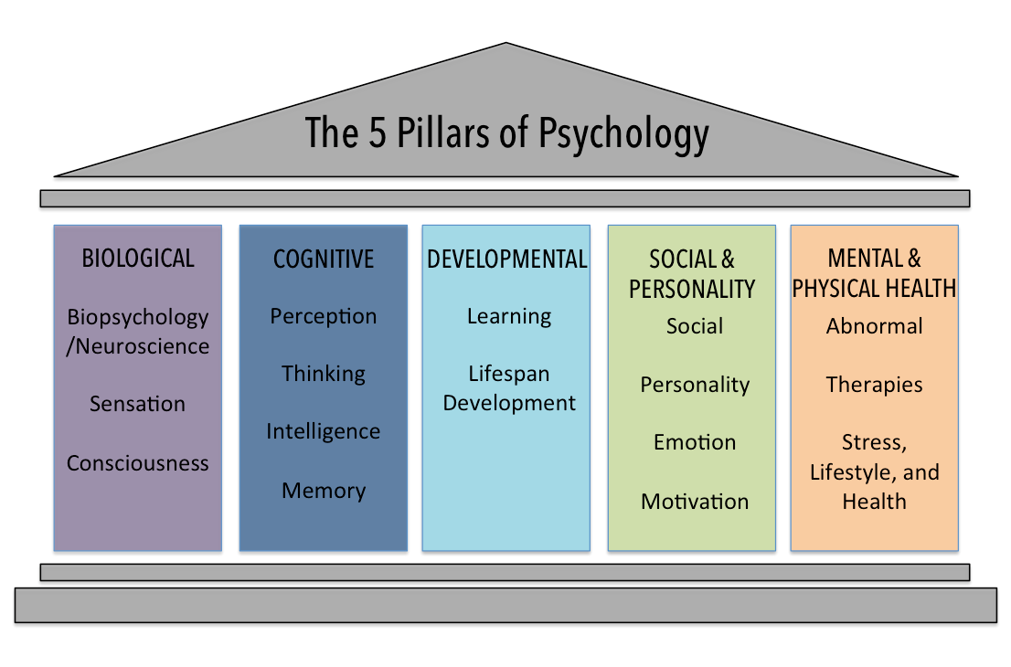

Slide 23
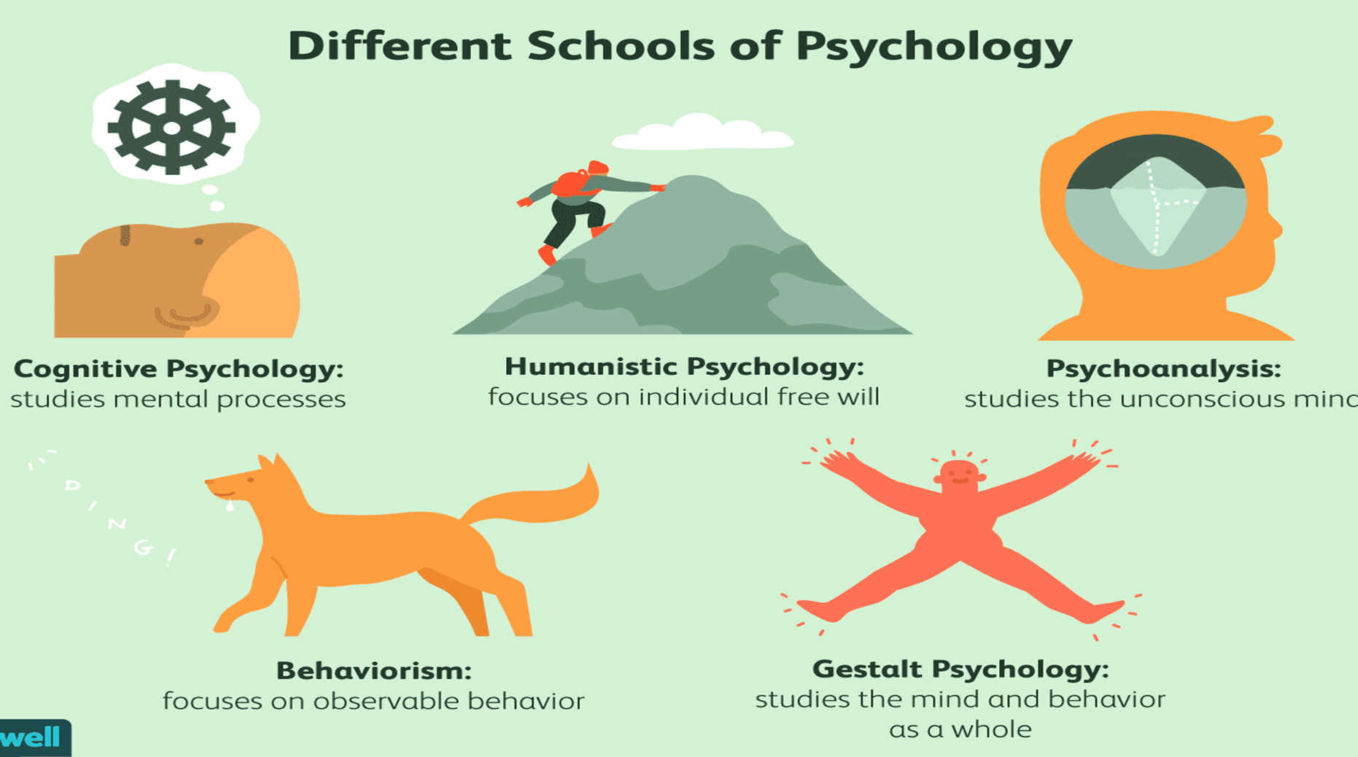

Slide 24
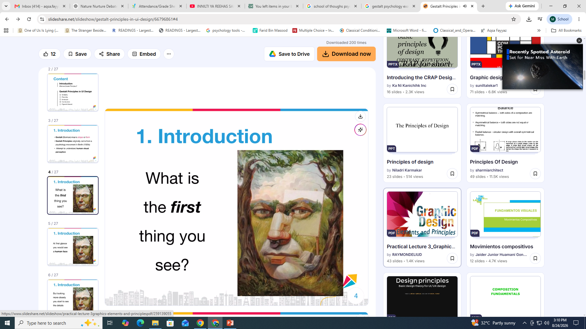

Slide 25



Slide 26


Slide 27


Slide 29
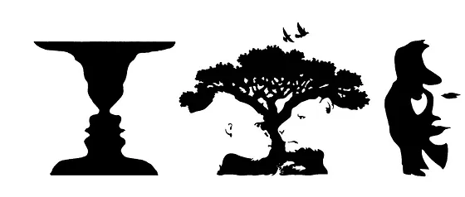

Slide 30
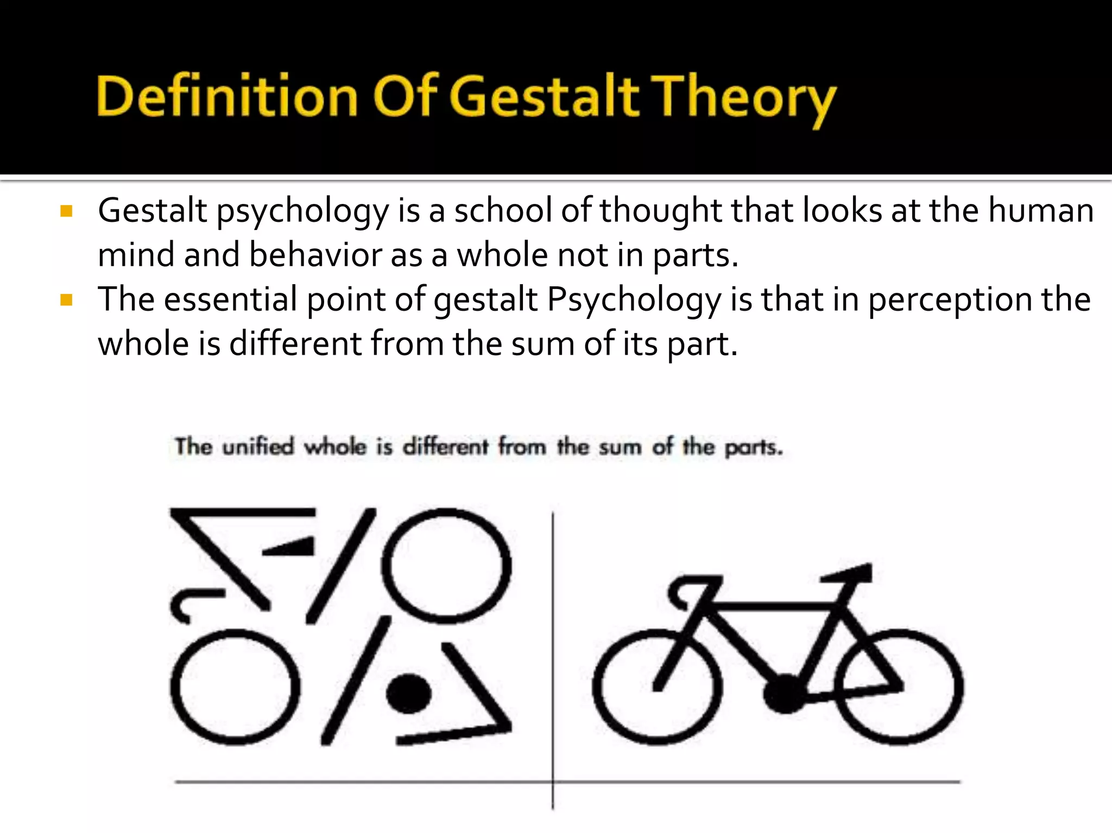

Slide 31

Gestalt psychology
Max Wertheimer (1880–1943), Kurt Koffka (1886–1941), and Wolfgang Köhler (1887–1967) founded Gestalt psychology in the early 20th century.
The whole is different from the sum of its parts.
Our perception or understanding of objects is greater and more meaningful than the individuals elements that make up our perceptions.

Slide 32
When trying to make sense of the world around us, Gestalt psychology suggests that we do not simply focus on every small component. Instead, our minds tend to perceive objects as part of a greater whole and as elements of more complex systems.
This school of psychology played a major role in the modern development of the study of human sensation and perception.

Slide 33

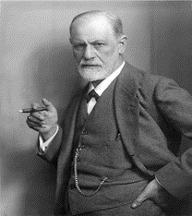
SIGMUND FREUD (1856-1939)
Austrian physician who founded the psychoanalytic approach to psychology.
Freud developed a theory based on the existence of the unconscious.
According to him emotional and behavioral disturbances were based on personal conflicts on an unconscious level.

Slide 34
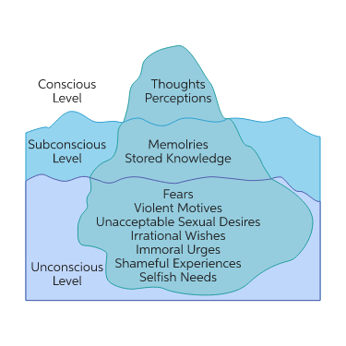
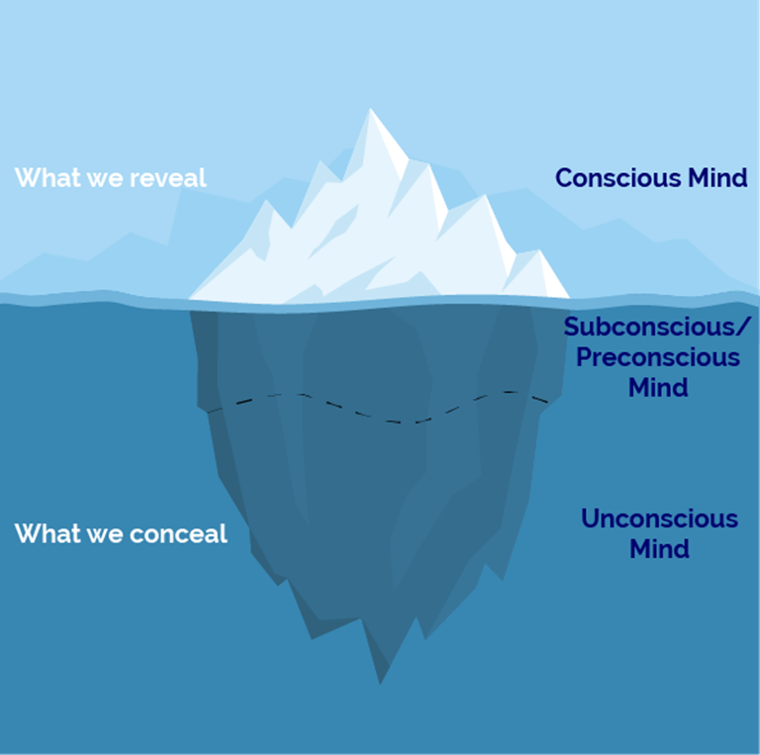
At the center of Freud’s theory is the concept of the unconscious – the thoughts, attitudes, impulses, wishes ,motivations, and emotions of which we are unaware.
Childhood’s unacceptable (forbidden or punished) wishes are driven out of conscious awareness and become part of the unconscious, where they continue to influence our thoughts, feelings, and actions.
Unconscious thoughts are
expressed in dreams, slips of the
tongue, and physical mannerisms.

Slide 35
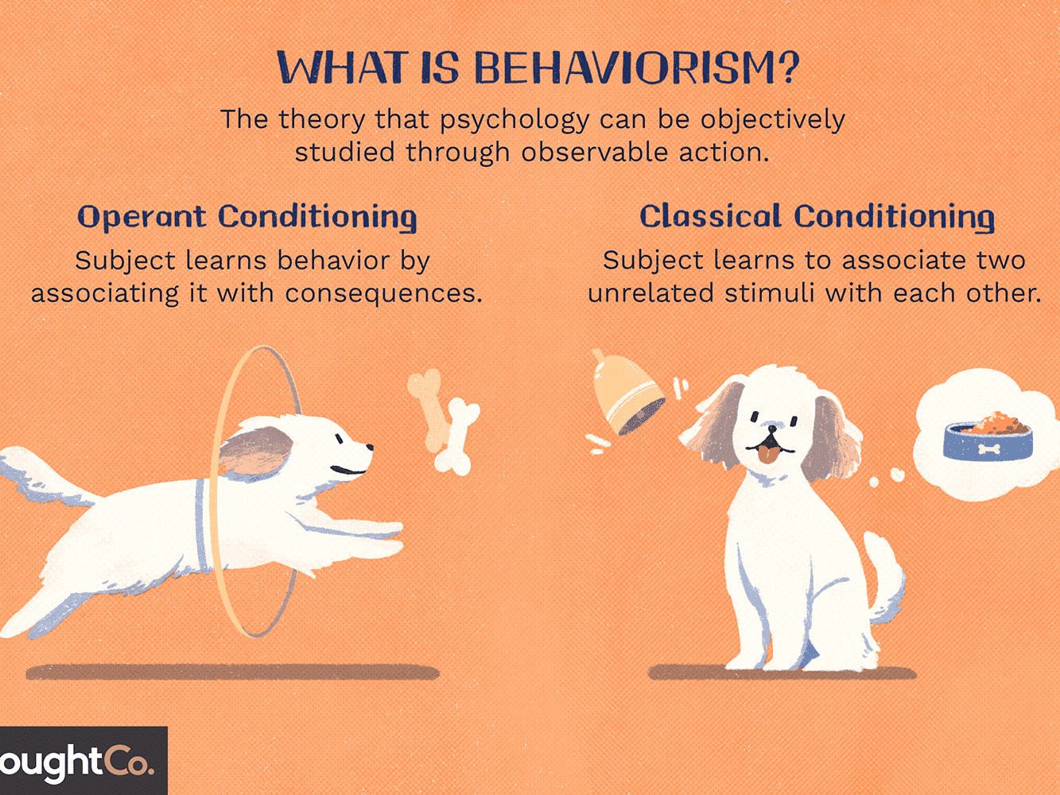
BEHAVIORISM
John B. Watson, in 1913 and others ascribing to behaviorism, argued that nearly all behavior is a result of conditioning and the environment shapes behavior by reinforcing specific habits.
It stated that scientists should only study observable behavior and that consciousness should be abandoned because ultimately consciousness and perceptions are private events and cannot be objectively verified.
This means that psychology would suffer from a lack of reliability.
Top names:
B.F Skinner
Ivan Pavlov

Slide 36
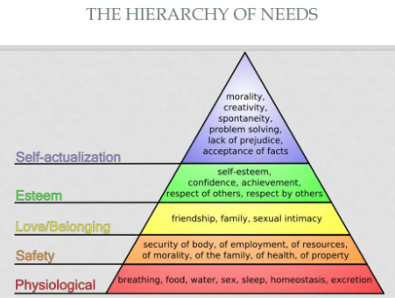
HUMANISTIC PERSPECTIVE
Humans are capable of incredible acts of creativity, selflessness & high levels of spirituality.
Free will
Main figures:
Carl Rogers , Abraham Maslow

Slide 37
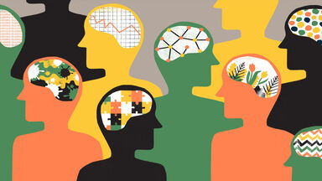
COGNITIVE PERSPECTIVE
Focus on Mental processes
Perceiving, remembering, reasoning, deciding, and problem solving
Only by studying mental processes can we fully understand what organisms do.

Slide 38
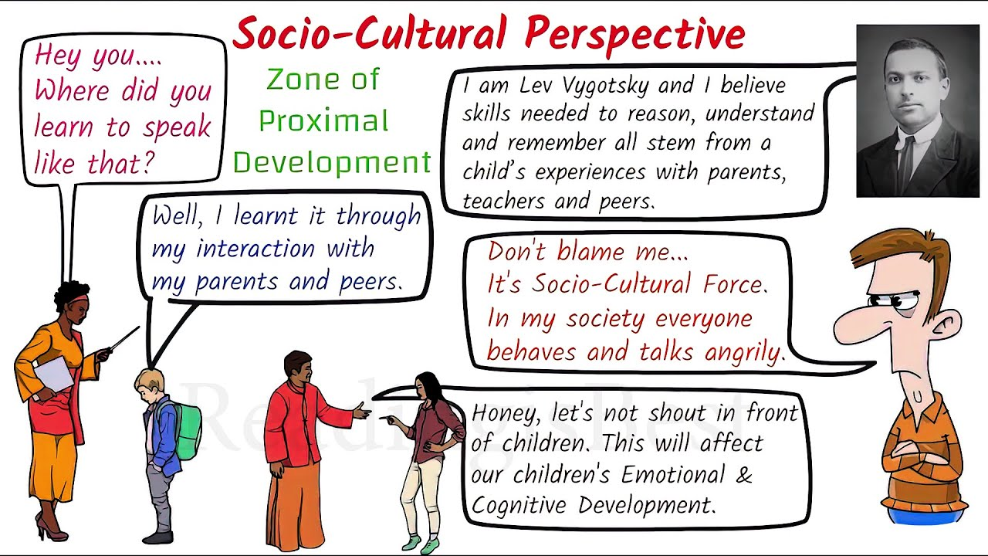
SOCIO-CULTURAL PERSPECTIVE
Sociocultural theory is an emerging theory in Psychology that looks at the important contributions that society makes to individual development.
Sociocultural theory focuses not only how adults and peers influence individual learning, but also on how and attitudes affect how learning takes place. cultural beliefs

Slide 39
This theory stresses the interaction between developing people and the culture in which they live.
Sociocultural theory also suggests that human learning is largely a social process.
EXAMPLES
Investigating how cultural factors influence psychological phenomena, such as emotional expression, cognitive processes, and social behaviors.
Studying how individuals adapt to new cultural environments and the impact of this process on their psychological well-being.

Slide 40

ECLECTIC APPROACH
Multi-modal or integrative therapy
Integration of Theories and Techniques
Flexibility in Methods
Customization to Client Needs
Selecting and adopting information from many different sources rather than relying on one perspective.

Slide 41


